Slide 1
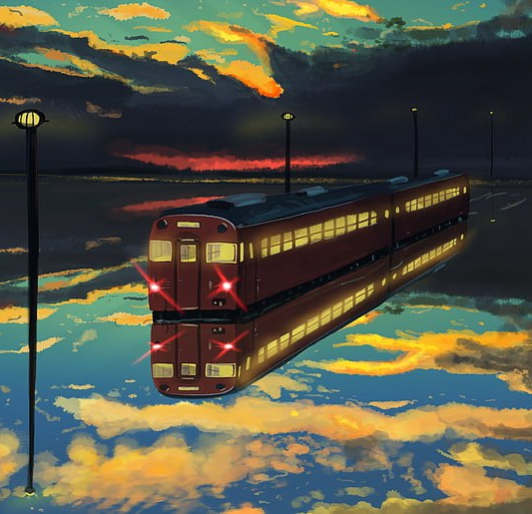
Midterm project: Railway

Slide 2

Target tasks:
Create enter page (by login and password)
Create registration page (for new users)
Create main page with opportunity to
search required track
buy tickets
cancel tickets
print out bought tickets

Slide 3

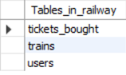
Organization of databases
Database of users
Database of trains
Database of bought tickets

Slide 4
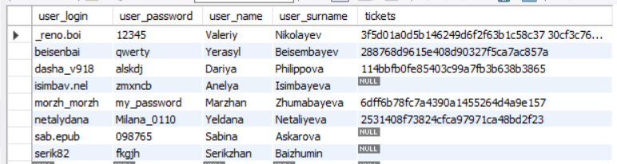
Database of users
Application:
Storing logins and password of users to enter page
Getting name, surname, bought tickets to create txt file
Primary key:
login

Slide 5
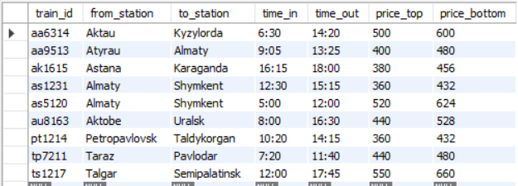
Database of trains
Application:
Storing id of trains, their tracks, time in, time, out, prices
Helping find user suitable train
Primary key:
Train ID

Slide 6
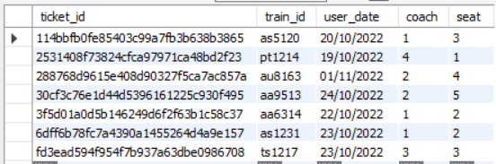
Database of tickets
Application:
Storing ticket connected data: train, date, coach and seat numbers
Checking vacant seats
Connection:
User database
Primary key:
Ticket ID

Slide 7
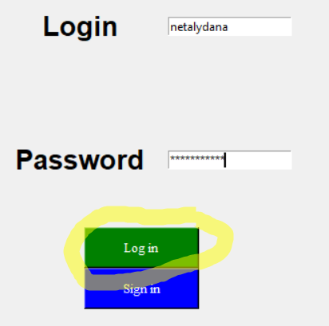
Enter page
1. def log_in():
2. global login_of_user
3. login_of_user = e_login.get()
4. password_of_user = e_password.get()
5. cursor.execute(f"SELECT * FROM users WHERE user_login = '{login_of_user}' and user_password = '{password_of_user}’”)
6. to_check = cursor.fetchall()
7. if to_check:
8. e_login.delete(0, END)
9. e_password.delete(0, END)
10. enter_frame.forget()
11. main_page_frame.pack()
12. else:
13. label_wrong = Label(enter_frame, text = "Wrong password or login", font=("Arial Bold", 11), fg="red", width = 20, height = 2).grid(row = 0, column = 0, columnspan = 2)

Slide 8
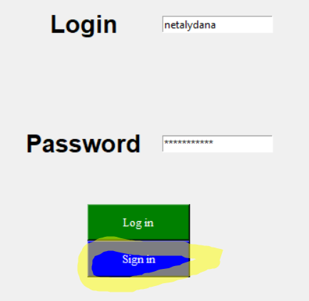
Log in page sign_in() function
1. def sign_in():
2. enter_frame.forget()
3. return_button = Button(sign_in_frame, text = "Return to \nprevious page", font=("Times New Roman", 10), bg="blue", fg="white", width = 15, height = 2, command = prev_page).grid(row = 7, column = 0)
4. sign_in_button = Button(sign_in_frame, text = "Sign in", font=("Times New Roman", 10), bg="blue", fg="white", width = 15, height = 2, command = register).grid(row = 7, column = 1)
5. sign_in_frame.pack()

Slide 9
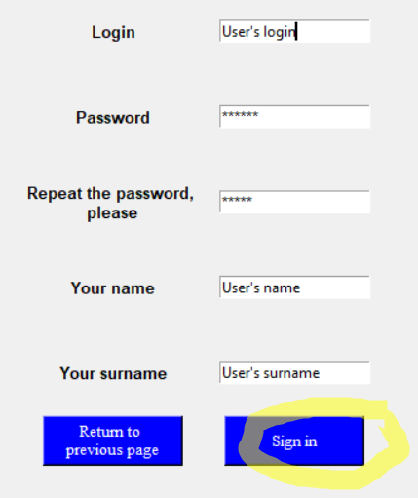
Sign in page register function()
def register():
global login_of_user
3. login_of_user = s_login.get()
4. password_of_user = s_password.get()
5. password2_of_user = s_password2.get()
6. name_of_user = s_name.get()
7. surname_of_user = s_surname.get()
8. cursor.execute(f"SELECT * FROM users WHERE user_login = '{login_of_user}’”)
9. to_check = cursor.fetchall()
10. mistakes_cnt = 0
11. label_wrong1 = Label(sign_in_frame, text = f"Passwords are different", font=("Arial Bold", 8), fg="red", width = 20, height = 2
12. label_wrong2 = Label(sign_in_frame, text = f"The login already exists \n in the base", font=("Arial Bold", 8), fg="red", width = 20, height = 2)
13. label_wrong3 = Label(sign_in_frame, text = f"Please, fill all gaps", font=("Arial Bold", 8), fg="red", width = 20, height = 2)

Slide 10
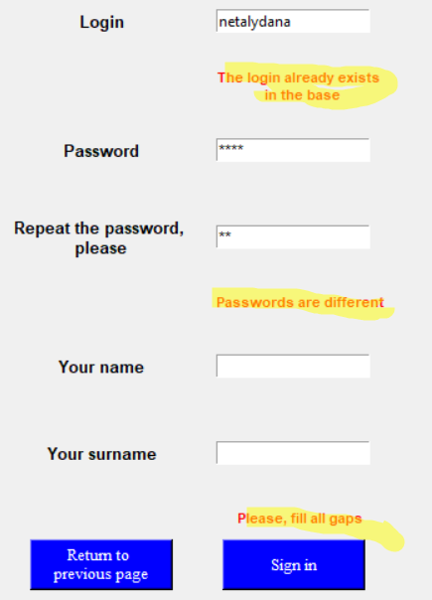
Checking for input data correctness
1. if password_of_user != password2_of_user:
2. label_wrong1.grid(row = 4, column = 1, columnspan = 2)
3. mistakes_cnt += 1
4. if len(to_check) != 0:
5. label_wrong2.grid(row = 1, column = 1, columnspan = 2)
6. mistakes_cnt +=1
7. if len(name_of_user)==0 or len(surname_of_user)==0 or len(login_of_user) == 0 or len(password_of_user) == 0 or len(password2_of_user) == 0:
8. label_wrong3.grid(row = 6, column = 1, columnspan = 2)
9. mistakes_cnt +=1
10. if mistakes_cnt == 0:
11. cursor.execute(f"INSERT INTO users (user_login, user_password, user_name, user_surname) VALUES ('{login_of_user}', '{password_of_user}', '{name_of_user}', '{surname_of_user}')")
12. db.commit()
13. sign_in_frame.forget()
14. main_page_frame.pack()

Slide 11
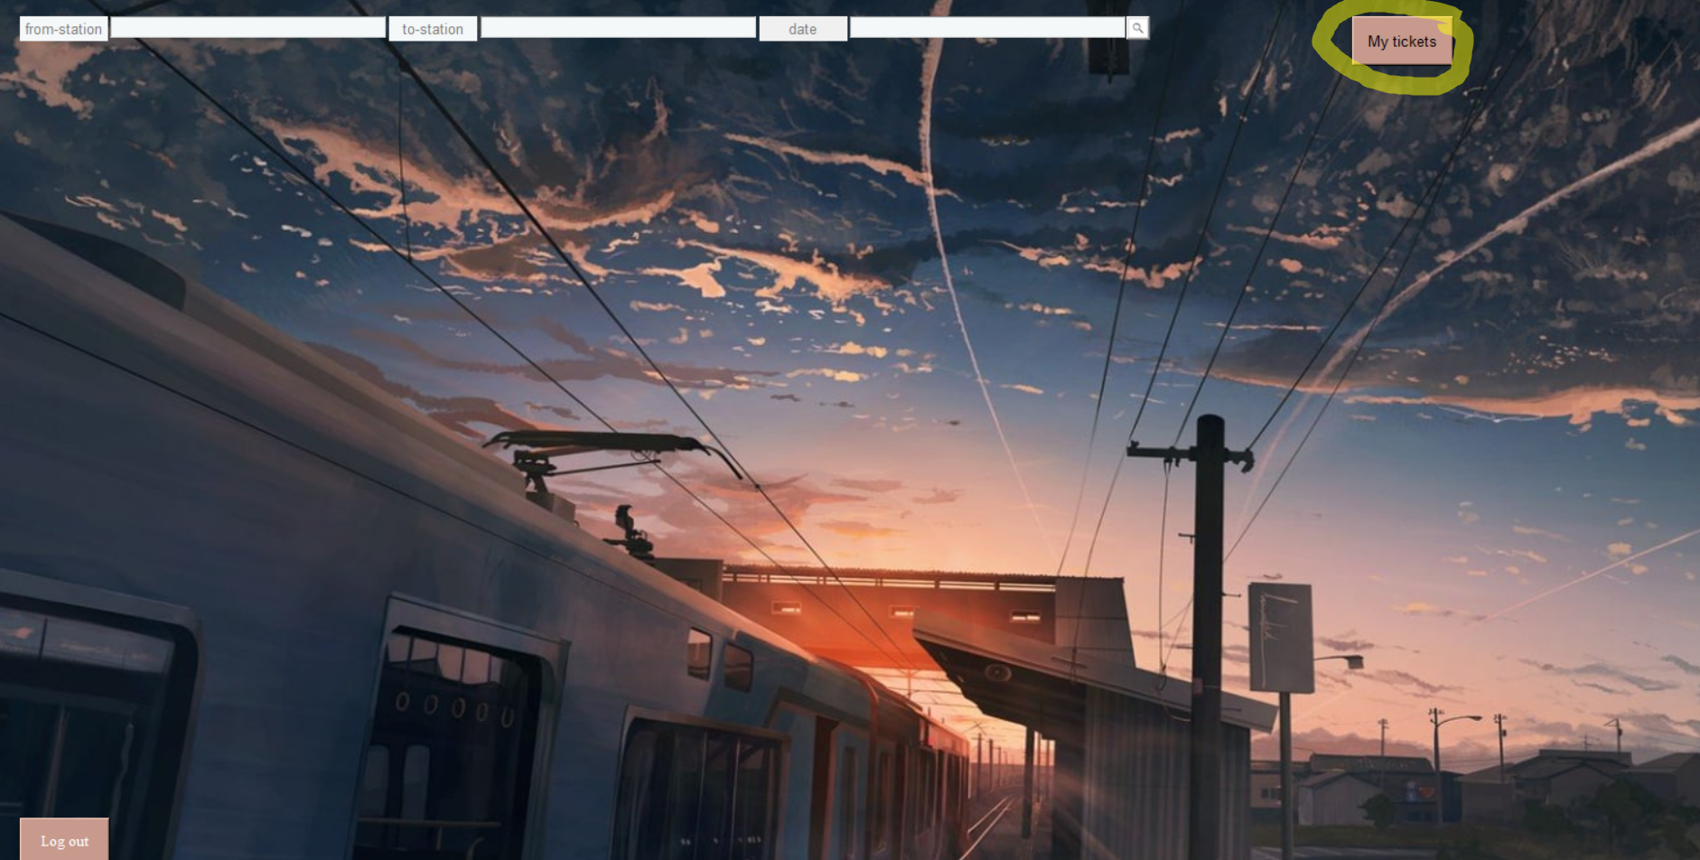
Main page showing user’s tickets
1. def show_tickets():
2. global tickets_label
3. main_page_frame.forget()
4. my_tickets_frame.pack()
5. global tickets_dictionary, tickets_text
6. cursor.execute(f'SELECT tickets FROM users WHERE user_login = "{login_of_user}“’)
7. temp = cursor.fetchall()
8. tickets_list = temp[0][0].split()
9. total = 0
10. cursor.execute(f'SELECT user_name, user_surname FROM users WHERE user_login = "{login_of_user}“’)
11. temp = cursor.fetchall()
12. tickets_dictionary["Name"] = temp[0][0]
13. tickets_dictionary["Surname"] = temp[0][1]
14. var = StringVar()
15. var.set("None")
16. to_print = ""

Slide 12
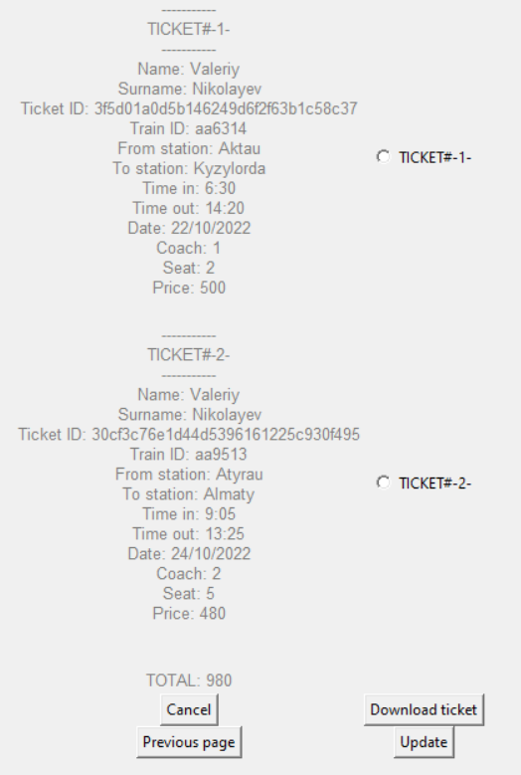
My tickets page printing out tickets data
1. for i in range(len(tickets_list)):
2. tickets_text +=f"-----------\nTICKET#-{i+1}-\n-----------\n"
3. cursor.execute(f'SELECT train_id, user_date, coach, seat FROM tickets_bought WHERE ticket_id = "{tickets_list[i]}“’)
4. ans = cursor.fetchall()
5. tickets_dictionary["Ticket ID"] = tickets_list[i]
6. tickets_dictionary["Train ID"] = ans[0][0]
7. cursor.execute(f'SELECT from_station, to_station, time_in, time_out, price_top, price_bottom FROM trains WHERE train_id = "{tickets_dictionary["Train ID"]}“’)
8. temp = cursor.fetchall()
9. tickets_dictionary["From station"] = temp[0][0]
10. tickets_dictionary["To station"] = temp[0][1]
11. tickets_dictionary["Time in"] = temp[0][2]
12. tickets_dictionary["Time out"] = temp[0][3]
13. tickets_dictionary["Date"] = ans[0][1]
14. tickets_dictionary["Coach"] = ans[0][2]
15. tickets_dictionary["Seat"] = ans[0][3]
16. if tickets_dictionary["Seat"] in range(1, 4):
17. tickets_dictionary["Price"] = temp[0][4]
18. else:
19. tickets_dictionary["Price"] = temp[0][5]
20.
21. total += tickets_dictionary["Price"]
22. for x in tickets_dictionary:
23. tickets_text += f"{x}: {tickets_dictionary[x]}\n"
24. tickets_label = Label(my_tickets_frame, text = tickets_text, font=("Playfair Display", 10), fg = "#80807e").grid(row = i, column = 0)
25. to_print += tickets_text
26. radiobutton = Radiobutton(my_tickets_frame, text=f"TICKET#-{i+1}-", variable=var, value=f'{tickets_dictionary["Ticket ID"]}').grid(row = i, column = 1)
27. tickets_text = ""

Slide 13
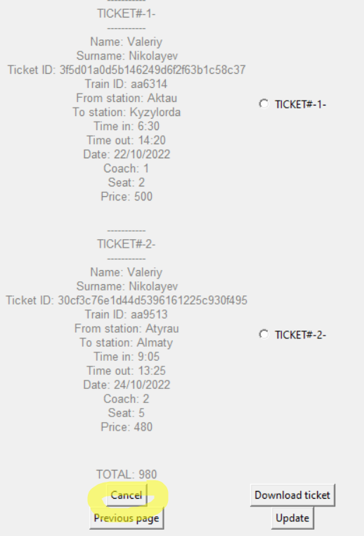
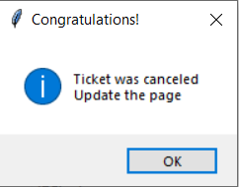
My tickets page canceling
def cancel():
if time_left_check():
temp = var.get()
query = f"DELETE FROM tickets_bought WHERE ticket_id = '{temp}'"
cursor.execute(query)
db.commit()
tickets_list.remove(temp)
temp = ""
for i in range(len(tickets_list)):
temp += f"{tickets_list[i]} "
query = f"UPDATE users SET tickets = '{temp}' WHERE user_login = '{login_of_user}'"
cursor.execute(query)
db.commit()
announce_cancel()
else:
mistake_label = Label(my_tickets_frame, text = "Less than 6 hours left.\nCancelation can't be done", font=("Playfair Display", 10), fg = "red").grid( row = len(tickets_list) +3, column = 0, columnspan = 2)
1. def time_left_check():
2. current_datetime = datetime.now()
3. day, month, year = map(int, tickets_dictionary["Date"].split("/"))
4. hour, minute = map(int, tickets_dictionary["Time in"].split(":"))
5. current_year = current_datetime.year
6. current_month = current_datetime.month
7. current_day = current_datetime.day
8. current_hour = current_datetime.hour
9. current_minute = current_datetime.minute
10. if current_year < year:
11. return True
12. elif current_month < month:
13. return True
14. elif day - current_day >=2:
15. return True
16. else:
17. if day - current_day ==1:
18. minute_left = (24 - current_hour)*60 + current_minute
19. minute_left += hour * 60 + minute
20. else:
21. minute_left = (hour - current_hour) * 60 + minute
22. if minute_left <= 360:
23. return False
24. else:
25. return True
def announce_cancel():
showinfo(
title = 'Congratulations!',
message = "Ticket was canceled\nUpdate the page"
)

Slide 14
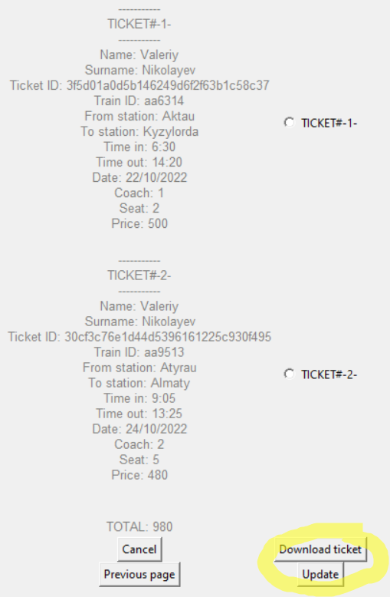
My tickets page downloading ticket and updating
def download_txt():
with open("receipt.txt", "w") as f:
f.write(to_print)
def clearFrame():
for widget in my_tickets_frame.winfo_children():
widget.destroy()
def update_page():
clearFrame()
show_tickets()

Slide 15
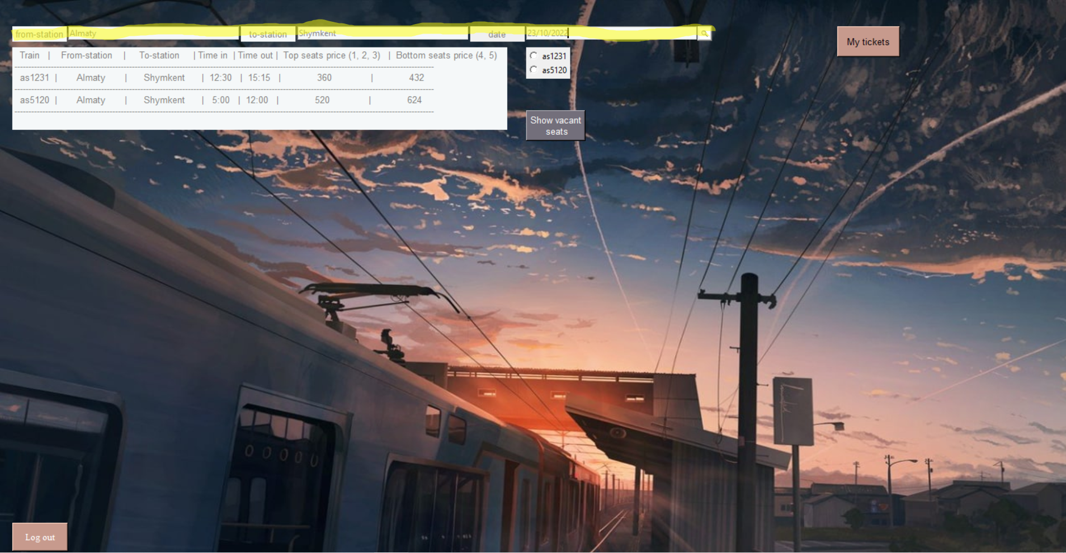
Main page searching
def search():
to_print = ""
from_station = from_station_entry.get()
to_station = to_station_entry.get()
date = date_entry.get()
query = f"SELECT * FROM trains WHERE from_station = '{from_station}' and to_station = '{to_station}'"
cursor.execute(query)
ans = cursor.fetchall()
to_print += '{train_id:^10}|{from_s:^20}|{to_s:^20}|{in_t:^10}|{out_t:^10}|{price_top:^30}|{price_bottom:^30}\n'.format(train_id = "Train", from_s = "From-station", to_s = "To-station", in_t = "Time in", out_t = "Time out", price_top = "Top seats price (1, 2, 3)", price_bottom = "Bottom seats price (4, 5)")
to_print = to_print + "-"*150 + "\n"
var = StringVar()
var.set("None")
dy = 70
for i in range(len(ans)):
to_print += '{train_id:^10}|{from_s:^20}|{to_s:^20}|{in_t:^10}|{out_t:^10}|{price_top:^30}|{price_bottom:^30}\n'.format(train_id = f"{ans[i][0]}", from_s = f"{ans[i][1]}", to_s = f"{ans[i][2]}", in_t = f"{ans[i][3]}", out_t = f"{ans[i][4]}", price_top = f"{ans[i][5]}", price_bottom = f"{ans[i][6]}")
to_print = to_print + "-"*150 + "\n"
radiobutton = Radiobutton(main_page_frame, text=f"{ans[i][0]}", variable=var, value=f'{ans[i][0]}').place(x = 755, y = dy)
dy +=20
ans_label = Label(main_page_frame, text = f"{to_print}", font=("Playfair Display", 10), bg = "#f5f8f9", fg = "#80807e", justify = "left").place(x = 20, y = 70)

Slide 16
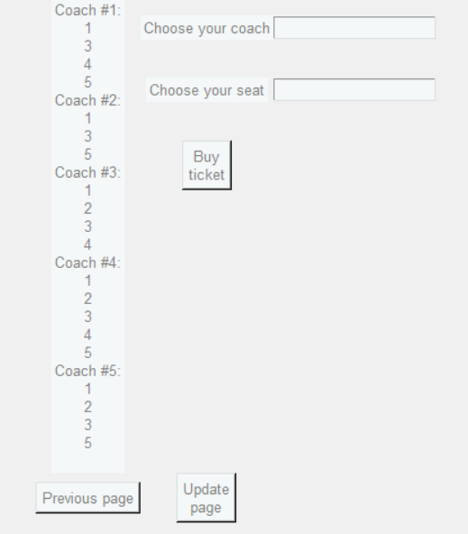
Vacant seats page displaying vacant seats
def show_vacant_seats():
main_page_frame.forget()
vacant_seats_frame.pack()
my_train = var.get()
query = f"SELECT * FROM tickets_bought WHERE train_id = '{my_train}' and user_date = '{date}'"
cursor.execute(query)
tickets = cursor.fetchall()
to_print = ""
coaches ={1 : [1, 2, 3, 4, 5], 2 : [1, 2, 3, 4, 5], 3 : [1, 2, 3, 4, 5], 4 : [1, 2, 3, 4, 5], 5 : [1, 2, 3, 4, 5]}
for i in range(len(tickets)):
coaches[tickets[i][3]].remove(tickets[i][4])
for i in range(len(coaches)):
to_print += f"Coach #{i+1}:\n"
for j in range(len(coaches[i+1])):
to_print += str(coaches[i+1][j])
to_print += "\n"
ans_label = Label(vacant_seats_frame, text = f"{to_print}", font=("Playfair Display", 10), bg = "#f5f8f9", fg = "#80807e").grid(row = 0, column = 0, rowspan = 10)
coach_label = Label(vacant_seats_frame, text = "Choose your coach", font=("Playfair Display", 10), bg = "#f5f8f9", fg = "#80807e").grid(row = 0, column = 1)
seat_label = Label(vacant_seats_frame, text = "Choose your seat", font=("Playfair Display", 10), bg = "#f5f8f9", fg = "#80807e").grid(row = 1, column = 1)
coach_entry = Entry(vacant_seats_frame, font=("Playfair Display", 10), bg = "#f5f8f9", fg = "#80807e")
coach_entry.grid(row = 0, column = 2)
seat_entry = Entry(vacant_seats_frame, font=("Playfair Display", 10), bg = "#f5f8f9", fg = "#80807e")
seat_entry.grid(row = 1, column = 2)

Slide 17
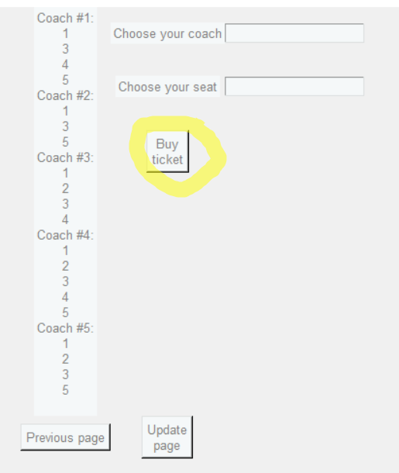
Vacant seats page buying tickets
def announce_purchase():
showinfo(
title = 'Congratulations!',
message = "Ticket was bought\nUpdate the page"
)
def buy():
coach = coach_entry.get()
seat = seat_entry.get()
if int(seat) in coaches[int(coach)]:
ticket_id = uuid.uuid4().hex
query = f"INSERT INTO tickets_bought (ticket_id, train_id, user_date, coach, seat) VALUES ('{ticket_id}', '{my_train}', '{date}', '{coach}', '{seat}')"
cursor.execute(query)
db.commit()
cursor.execute(f'SELECT tickets FROM users WHERE user_login = "{login_of_user}"')
temp = cursor.fetchall()
tickets_list = temp[0][0].split()
tickets_list.append(ticket_id)
temp = ""
for i in range(len(tickets_list)):
temp += f"{tickets_list[i]} "
cursor.execute(f"UPDATE users SET tickets = '{temp}' WHERE user_login = '{login_of_user}'")
db.commit()
announce_purchase()
else:
label_wrong = Label(vacant_seats_frame, text = "Seat is not vacant", font=("Playfair Display", 10), bg = "#f5f8f9", fg = "red").grid(row = 3, column = 1)

Slide 18
Self-study
Using
Using radiobuttons, message boxes, frames
Adding
Adding image to the background
Displaying
Displaying “*” signs in password entry
Clearing
Clearing widgets in frame, text from entry
Creating
Creating unique ID using universally unique identifier library

Slide 19
Thank for your attention

